Slide 1
Variables, Measurement error, Validity and Reliability
Dr. Karen Gamble

Slide 2
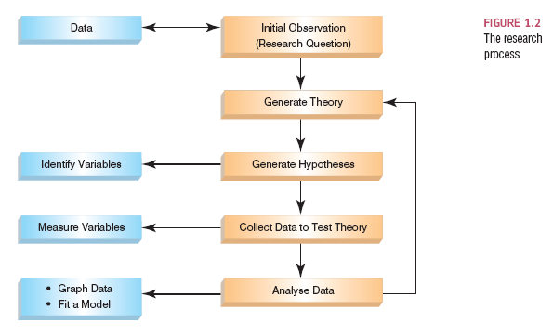
The Research Process

Slide 3
Collect Data to Test Your Theory
Hypothesis:
Caffeine increases blood pressure.
Independent Variable
The proposed cause
A predictor variable (in observational studies)
A manipulated variable (in experiments)
Caffeine in the hypothesis above
Dependent Variable
The proposed effect
An outcome variable
Measure(s) being studied (in experiments)
Blood pressure in the hypothesis above

Slide 4
Levels of Measurement
Categorical (measurements are divided into distinct categories):
Nominal variable: categories do not have a distinct order
e.g. male / female, knockout / wild-type, etc.
Binary variable: nominal variable with only two categories
e.g. dead / alive
Ordinal variable: categories have a logical order
e.g., body condition score.

Slide 5
Levels of Measurement
Continuous (measurements can take on an infinite number of values):
Interval variable: Equal intervals on the variable represent equal differences in the property being measured
e.g. the difference between 6 and 8 is equivalent to the difference between 13 and 15.
Ratio variable: The same as an interval variable, but the ratios of scores on the scale must also make sense
e.g. a quantification of a western blot lane after normalization is 1.5 and means that that sample is, in reality, 50% greater than the control.

Slide 6
Measurement Error
Measurement error
The discrepancy between the actual value we’re trying to measure, and the number we use to represent that value.
Examples:
Your mouse (in reality) weighs 30.5 g. Your lab scale reads 30.6 g. The measurement error is 0.1 g.

Slide 7
Validity
Whether an instrument measures what it set out to measure.
Content validity
Evidence that the content of a test corresponds to the content of the construct it was designed to cover
Ecological validity
Evidence that the results of a study, experiment or test can be applied, and allow inferences, to real-world conditions.

Slide 8
Reliability
Reliability
The ability of the measure to produce the same results under the same conditions.
Test-Retest Reliability
The ability of a measure to produce consistent results when the same entities are tested at two different points in time.

Slide 9
How to Measure
Correlational research:
Observing what naturally goes on in the world without directly interfering with it.
Cross-sectional research:
This term implies that data come from subjects in different conditions with different subjects representing each condition.
Experimental research:
One or more variable is systematically manipulated to see their effect (alone or in combination) on an outcome variable.
Statements can be made about cause and effect.

Slide 10
Experimental Research Methods
Cause and Effect (Hume, 1748)
Cause and effect must occur close together in time (contiguity);
The cause must occur before an effect does;
The effect should never occur without the presence of the cause.
Confounding variables: the ‘Tertium Quid’
A variable (that we may or may not have measured) other than the predictor variables that potentially affects an outcome variable.
E.g. The relationship between NSAIDs and all-cause mortality may be confounded by functional status.
E.g. Differences in food intake in rodents may confound behavioural task performance.
Requires inclusion of proper controls in experimental design
E.g., Including Cre+ group in absence of floxed gene.

Slide 11
Methods of Data Collection
Between-group/Between-subject/independent
Different subjects in experimental conditions
Repeated measures (within-subject)
The same subjects take part in all experimental conditions.
Economical
Order or learning effects
Fatigue
Loss to follow-up

Slide 12
Types of Variation
Systematic Variation
Differences in performance (e.g., memory task) created by a specific experimental manipulation (e.g., stress or no stress).
Unsystematic Variation
Differences in performance created by unknown factors.
Age, Sex, Strain, Time of day, Measurement error etc.
Randomization
Minimizes unsystematic variation.

Slide 13

Replication
Requires a precise process where the exact same findings are reexamined in the same way with identical design, power, subject selection requirements, and level of significance as the original research study
Rigor and Reproducibility

Slide 14
Replicates
Biological replicates:
Parallel measurements of biologically distinct samples that capture random biological variation, which may itself be a subject of study or a source of noise.
Technical replicates:
repeated measurements of the same sample that represent independent measures of the random noise associated with protocols or equipment

Slide 15
Questions on Replication
Within an individual experiment, what do you think is the best approach to determine the appropriate number of replicates?
Is it appropriate to leave out information about the type of replicates and plot the data in such a way as to suggest significance over multiple experiments?
Do you think papers or grant applications should delineate the use of biological vs. technical replicates in the figure legends (or elsewhere in the document)?

Slide 16
The Research Process

